Slide 1
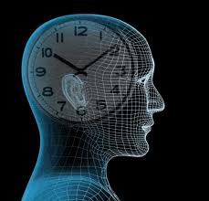
The Biological Clock
A sign of many signs by Allah Almighty
Written by: ABDEL DAYEM AL KAHEEL
www.kaheel7.com
Translated by : Rajaa AL Lawatia
my_hope2020@yahoo.com
Prepared by: Ahmed Adham
ahmed.adham.eg@gmail.com

Slide 2
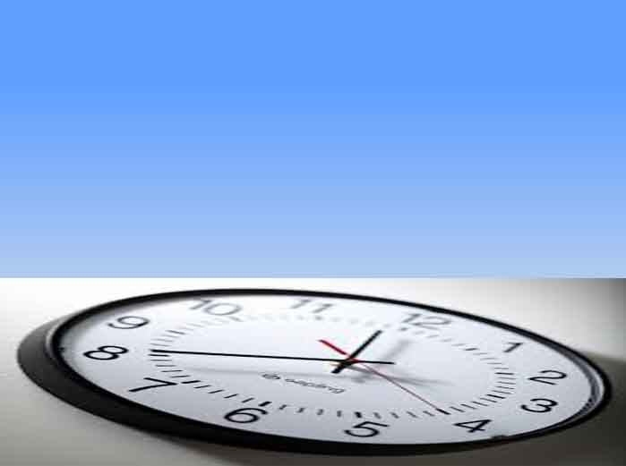
Scientists talked about a very precise clock within each one of us, such clock is there within each part of our body which doesn’t make a mistake.
So, what is the truth about this clock ?

Slide 3
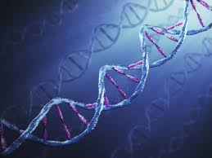
Finally, scientists began to discover the truth about the biological clock inside our bodies and found out that it is there in every cell of our body!
There are specific genes within the cell responsible for time keeping.

Slide 4
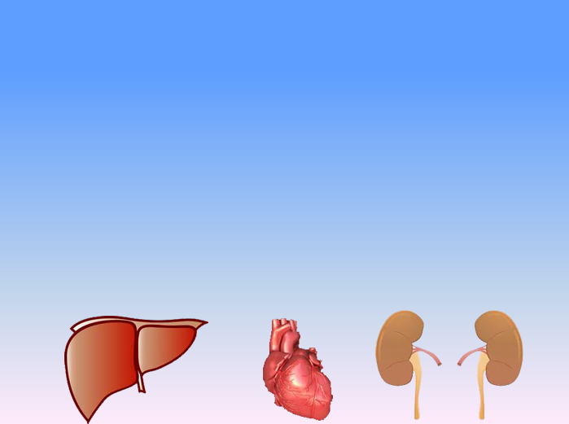
There is a special clock in the heart to set its beats,
in the liver there is also a clock to set the operation
of toxin filtering .
Another special clock is in the kidney to regulate urination. So, in every part and every cell of our body, there is a clock for time keeping!

Slide 5



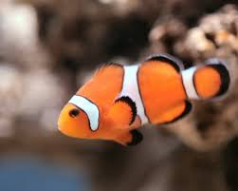
This clock is in all creatures such as mice, butterflies and all animals and fish. As well as plants, so Allah Almighty provides every living thing with a precise clock to set its vital operations.

Slide 6

Therefore when we isolate a human in a dark cave, we change the natural conditions, so he no longer see light or the sun and he doesn`t know the time if night or daytime. In spite of that, the body systems will do their roles (biological processes) and he will sleep and wake up early as usual.

Slide 7

This clock works in space too, in the absence of gravity. The astronaut's body does all processes despite the loss
of gravity and the clock also organizes the processes of sleeping, waking and the desire for food.
It works constantly over 24 hours without stopping.

Slide 8
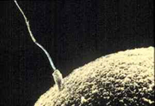
The biological clock starts to function from the first moment of creation of man. The sperm starts fertilizing the ovum then time goes on and the cell division begins with one cell and ends with several trillions cells, which is human. All of this is in accordance with an accurate calculated and estimated system.
Glory to Allah for His creation

Slide 9
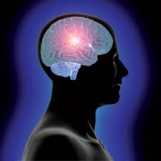
The front part of brain
Scientists have found that the biological clock is a group of cells located in the front part of the brain in the forehead area behind the eyes.
This clock send signals constantly to the body to carry out its operations in a precise system.

Slide 10
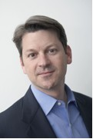
Zack Lynch the author of “ How Brain Science Is Changing Our World “ says: Actually, brain imaging has shown that the frontal lobes may be divided into seventeen or more sub regions, each responsible for a slightly different kind of work that the human performs. So a problem anywhere in this area will impact the way a child approaches and performs any task. Thus, this area organizes the whole body work and has an important role in disease treatment.

Slide 11
Here, Allah Almighty say some clear words in the holy book of Qur’an:
"I put my trust in Allah, my Lord and your Lord! There is not a moving creature but He has the grasp of its forelock. Verily, my Lord is on the Straight Path (the truth).”(Sûrat Hood- verse 56)

Slide 12
Conclusion

Slide 13
Scientists say that:
There is a very accurate biological clock, within each cell of our body, which controls all the biological processes from human`s birth until his death.
There is a program located in each cell which works in an accurate steps without any exception.
This clock has been programmed to tick a certain number of ticks no more or less.
When the last tick is ticked, death will come and never delayed.
Allah Almighty describes the death moment by saying:
(And if Allâh were to seize mankind for their wrong-doing, He would not leave on it (the earth) a single moving (living) creature, but He postpones them for an appointed term and when their term comes, neither can they delay nor can they advance it an hour (or a moment). (Surat Al Nahel -verse 61)

Slide 14
Let us ask those atheists who believe that universe was found by chance:
how does these very accurate processes work within tens of billions of cells in the human body?
If the system of one cell becomes defective , the whole body will become defective.
Who placed a biological vital clock in each cell of humans, plants and animals which doesn`t need maintenance and doesn`t delay or go forward?

Slide 15
Indeed He is
Allah Almighty the creator of all things

Slide 16
References
1- Keith McKeown , New "Clock Gene" Uncovered, The Scripps Research Institute, 2004.
2- Link found between body rhythms and circadian clock, light, Harvard College, 2002.
3- Bengt Jansson, Controversial Psychosurgery Resulted in a Nobel Prize, www.nobelprize.org, October 29, 1998.
4- Zack Lynch, The Search for Emotional Truth, www.corante.com, November 10, 2006.
http://news.harvard.edu/gazette/tag/circadian-rhythm/
http://news.harvard.edu/gazette/story/2009/03/researchers-find-potential-cause-of-heart-risks-for-shift-workers/
http://news.harvard.edu/gazette/tag/circadian-rhythm/
http://science.howstuffworks.com/dictionary/biology-terms/biological-clock-info.htm

Slide 17
We have to supplicate Allah by saying :
(Our Lord! Let not our hearts deviate(from the truth) after You have guided us, and grant us mercy from You. Truly, You are the Best granter.)
( Sûrat Âl-Imrân- verse 8)
Please , forwarded this research to your friends
www.kaheel7.com

